Slide 1
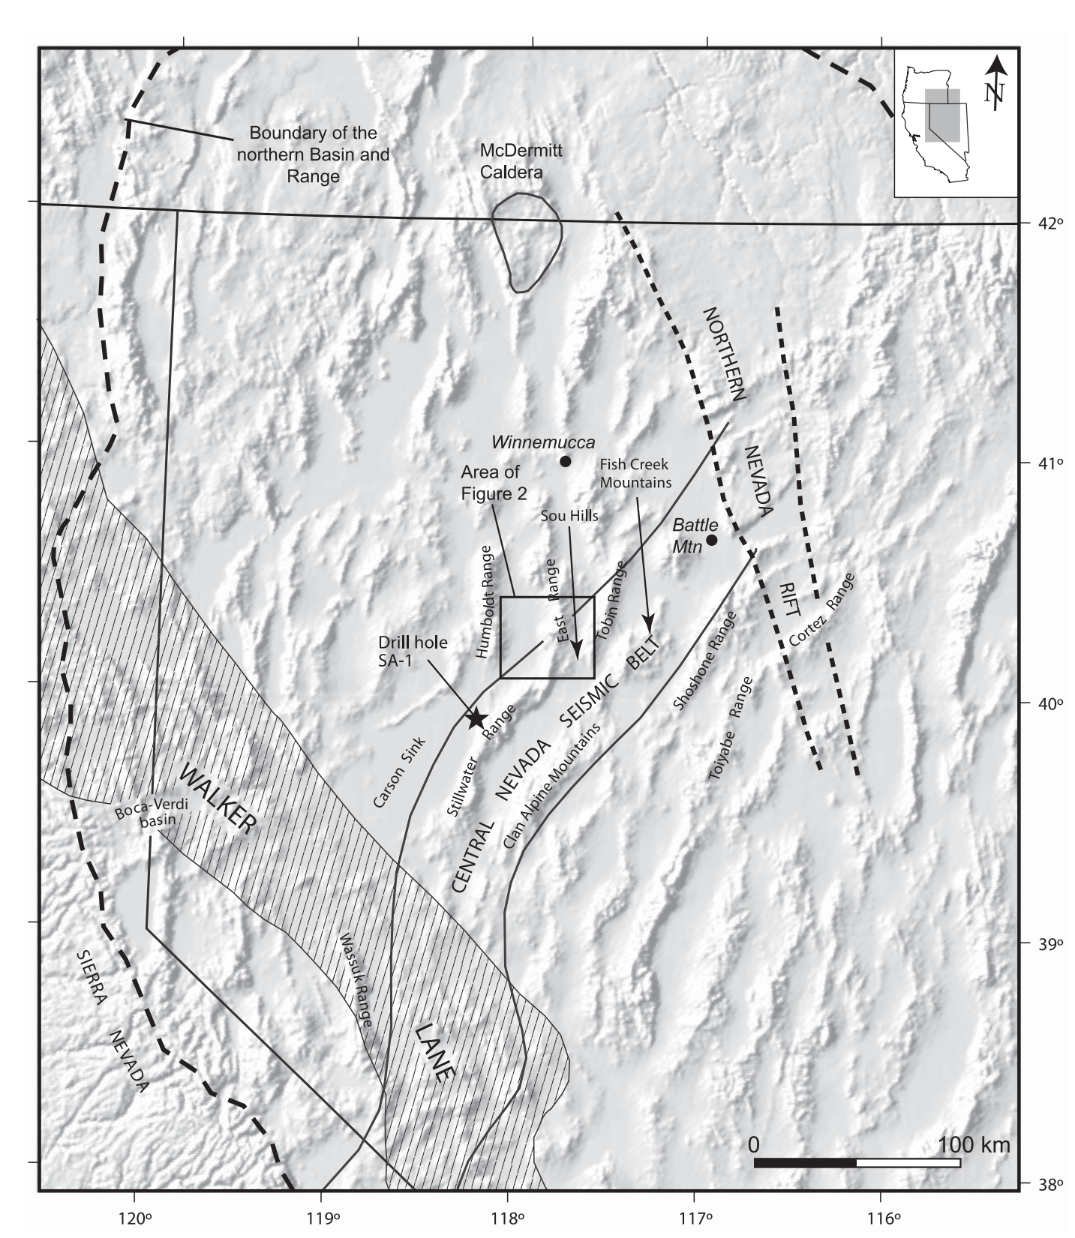
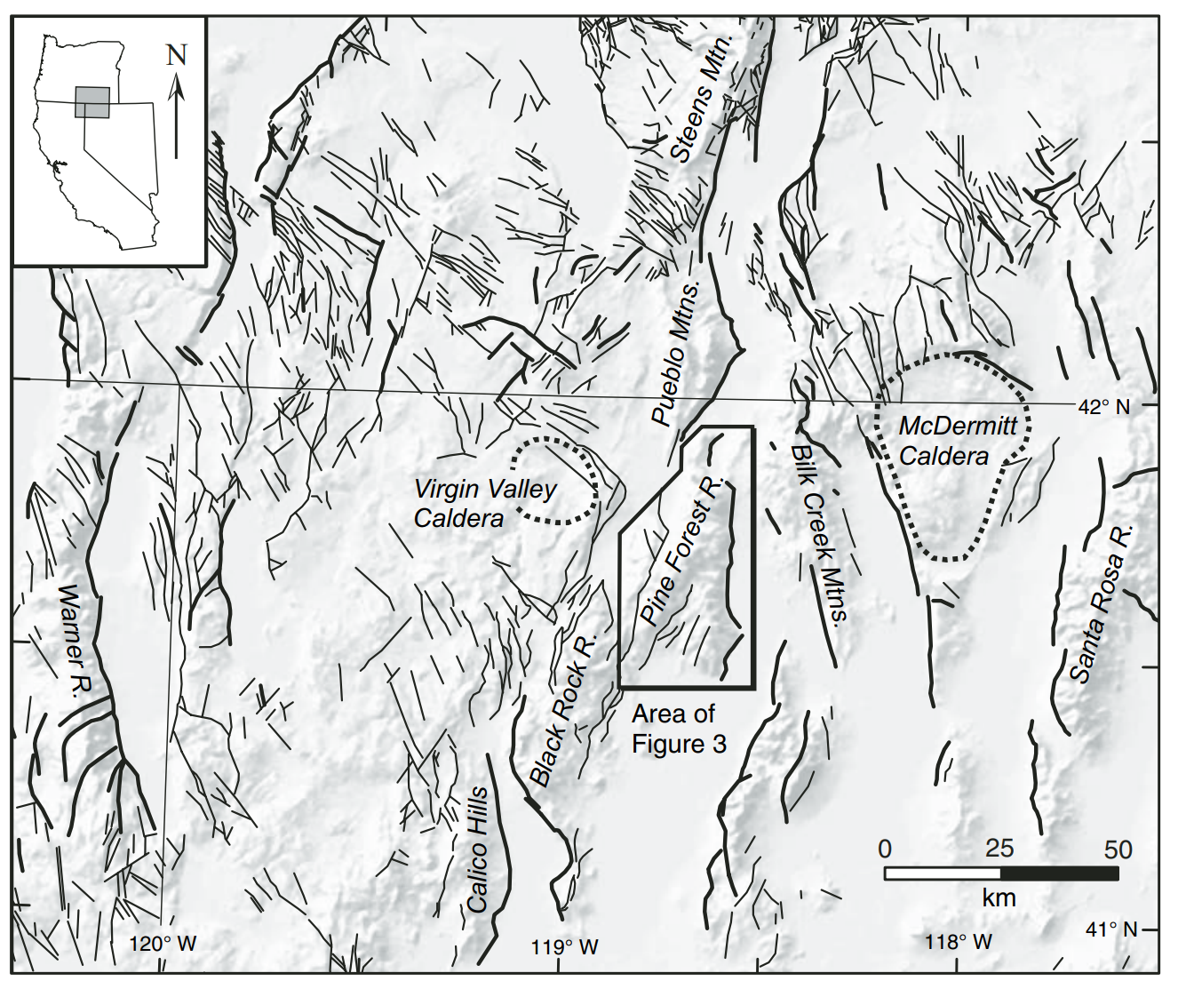
Cenozoic Volcanism and Miocene Extension in the Basin and Range Province
Colgan, 2006
Fosdick and Colgan, 2008
Ryan Parkyn

Slide 2
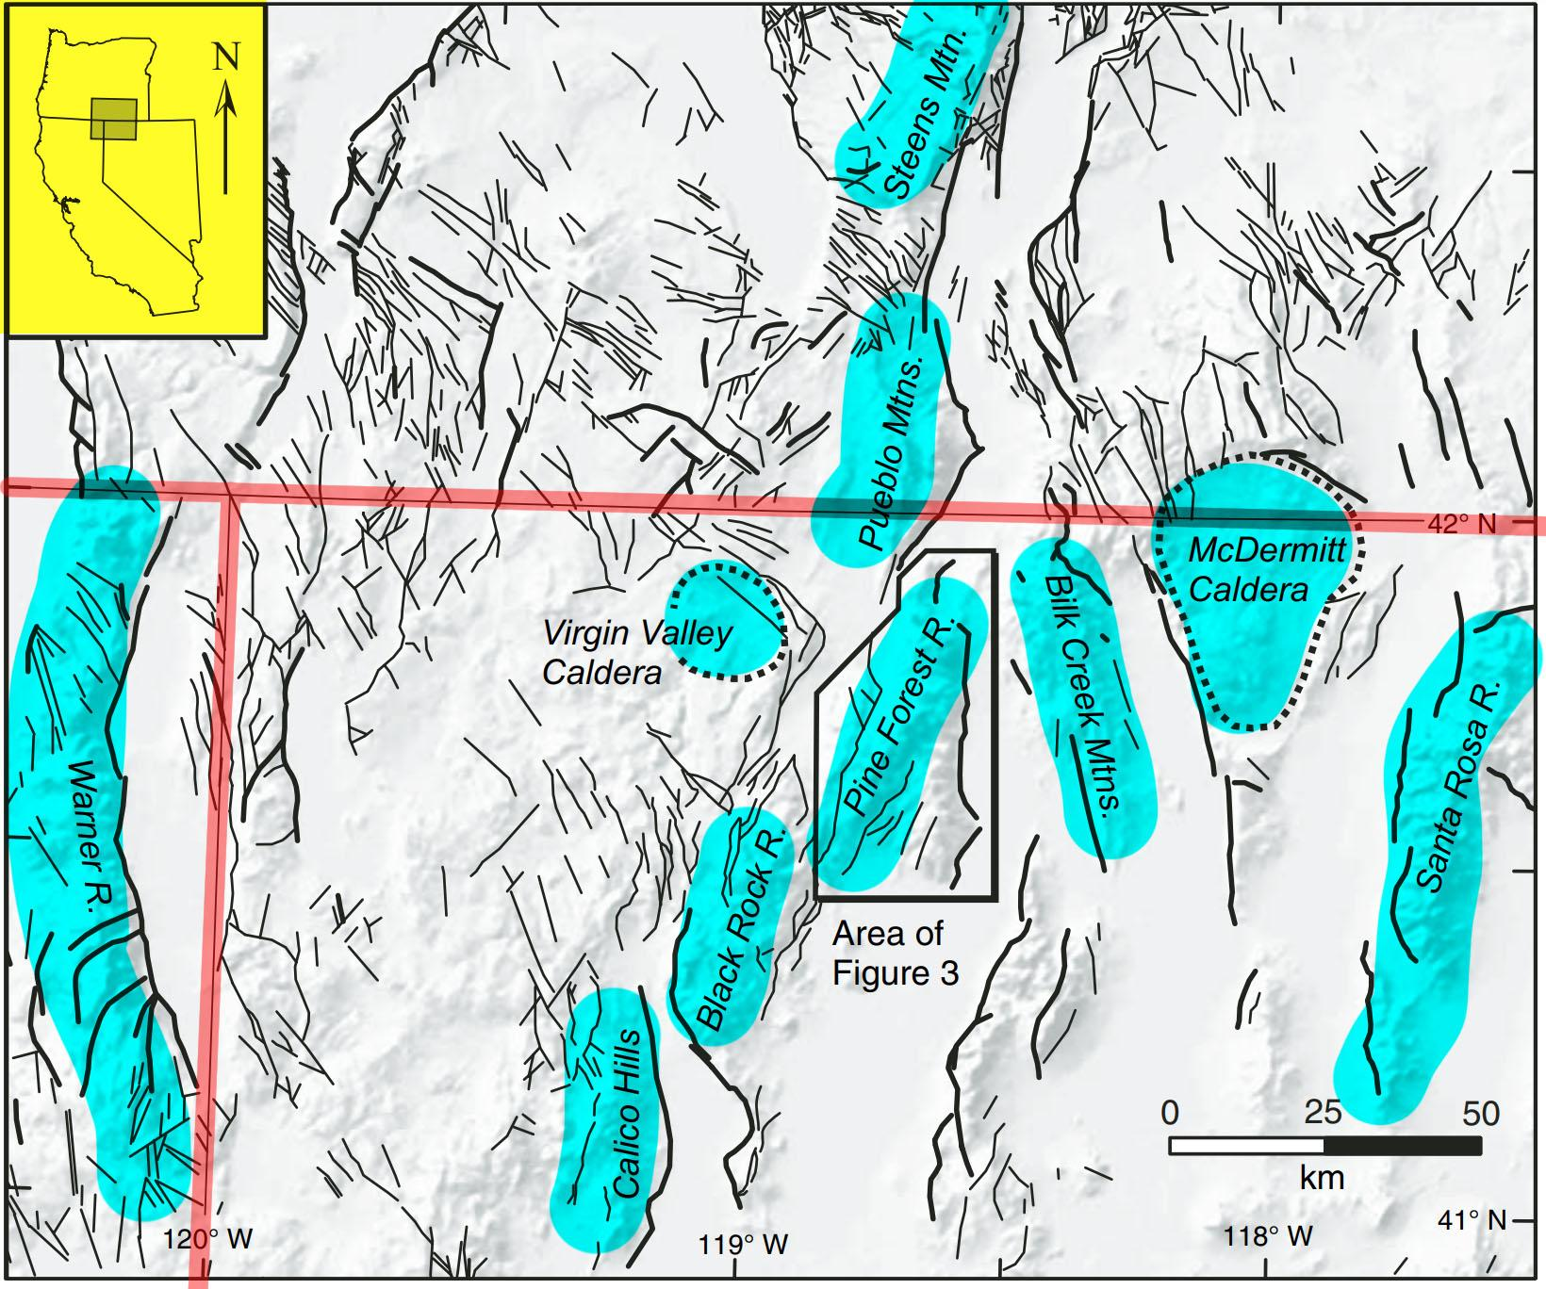
Colgan 2006: Evidence of extension from tilting of volcanic rocks prior to normal faulting in Pine Forest Range, Nevada
Basin and range faulting was less understood in the Northwest
Pine Forest Range rotated + tilted 30-35° likely in single event
NW Nevada extension occurred later than the rest of the basin and range

Slide 3
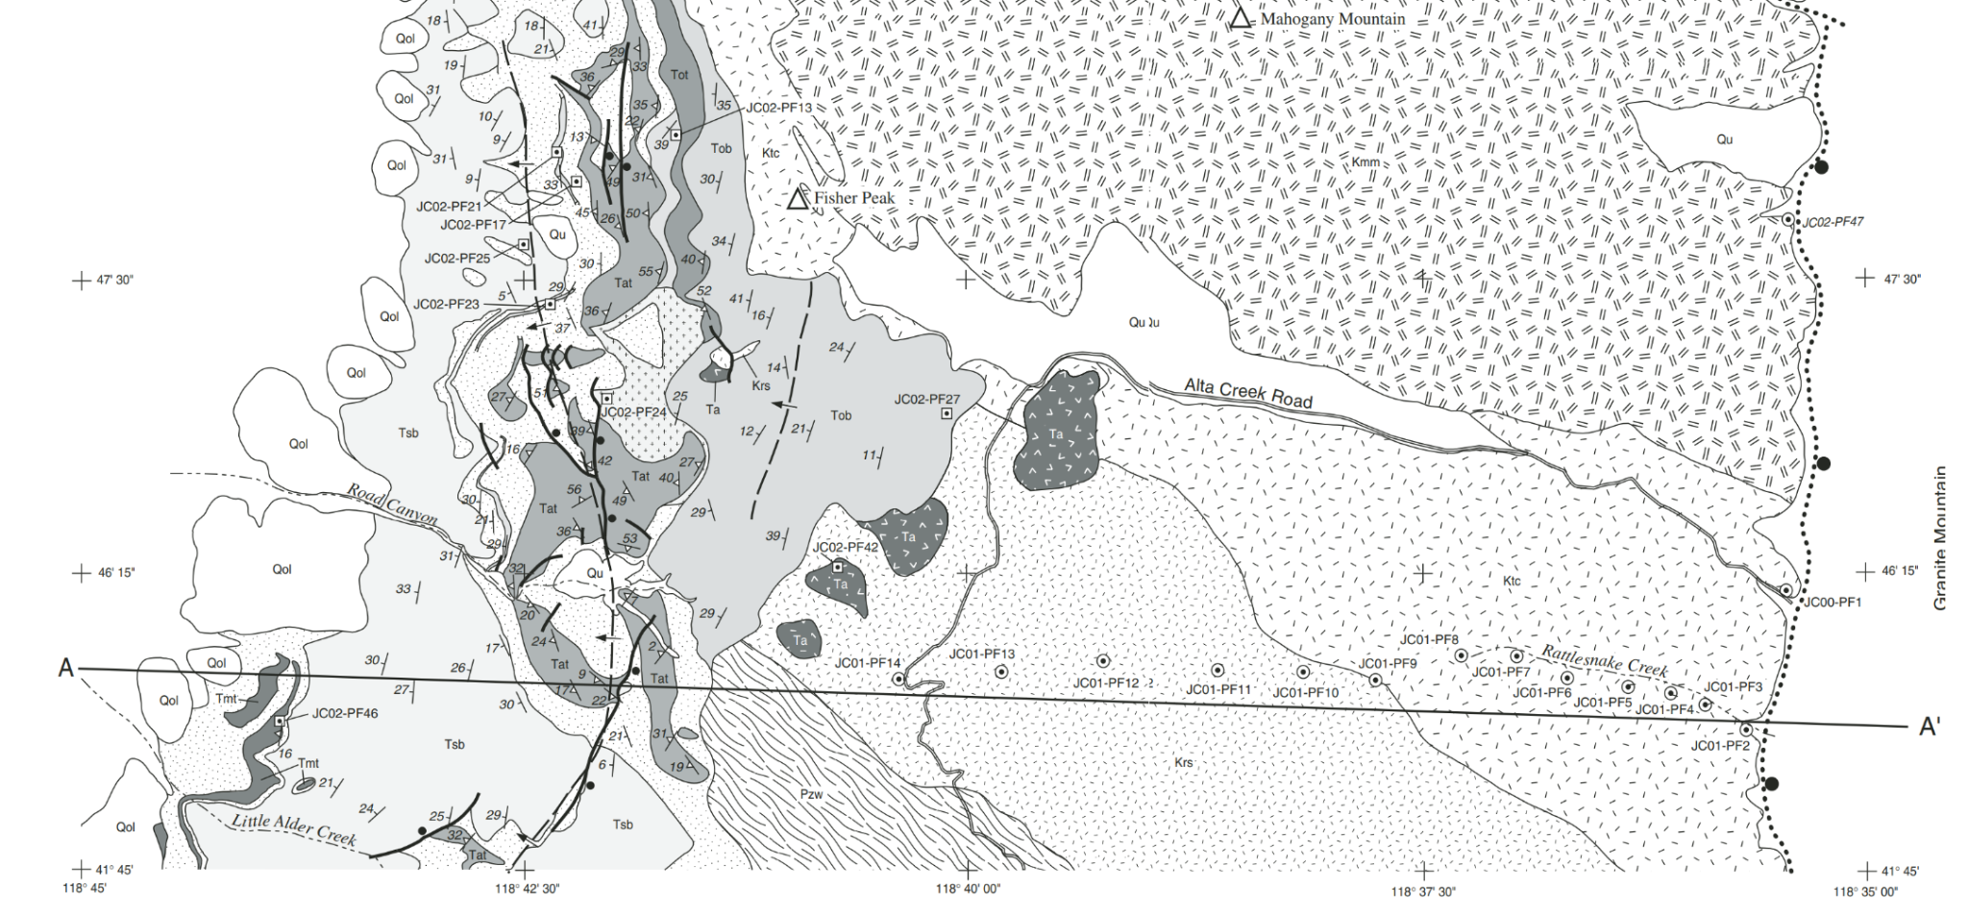
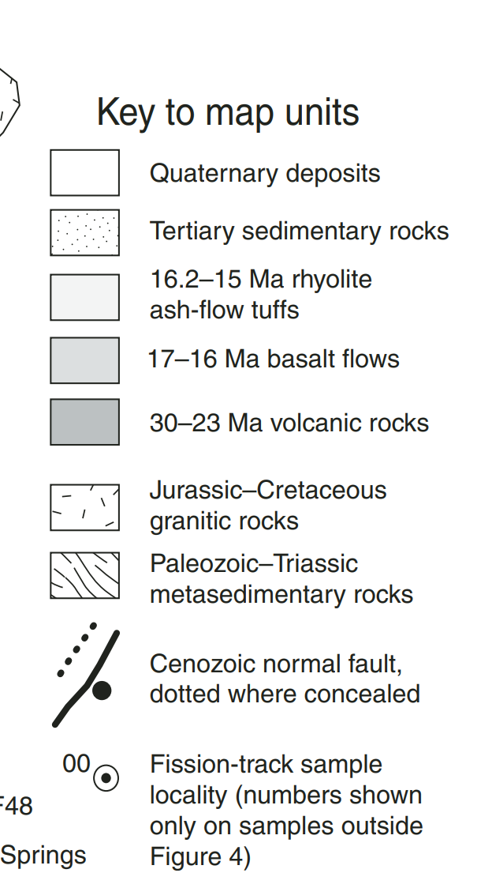
Methods to constrain Tertiary normal faulting
Map + new crystallization ages (3 episodes of volcanism)
Geochemistry: Major + trace element data
Apatite thermochronology

Slide 4
Fission Track Data = Timing of slip
Apatite ages collected along footwall Granite Mountain pluton along E-W transect
Records paleodepth
<1km = older unrelated cooling
1.8-3.9km= progressively younger (Within partial anneal zone, 60°-110°C)
>4km= reset prior to exhumation (>110°-135°C)

Slide 5
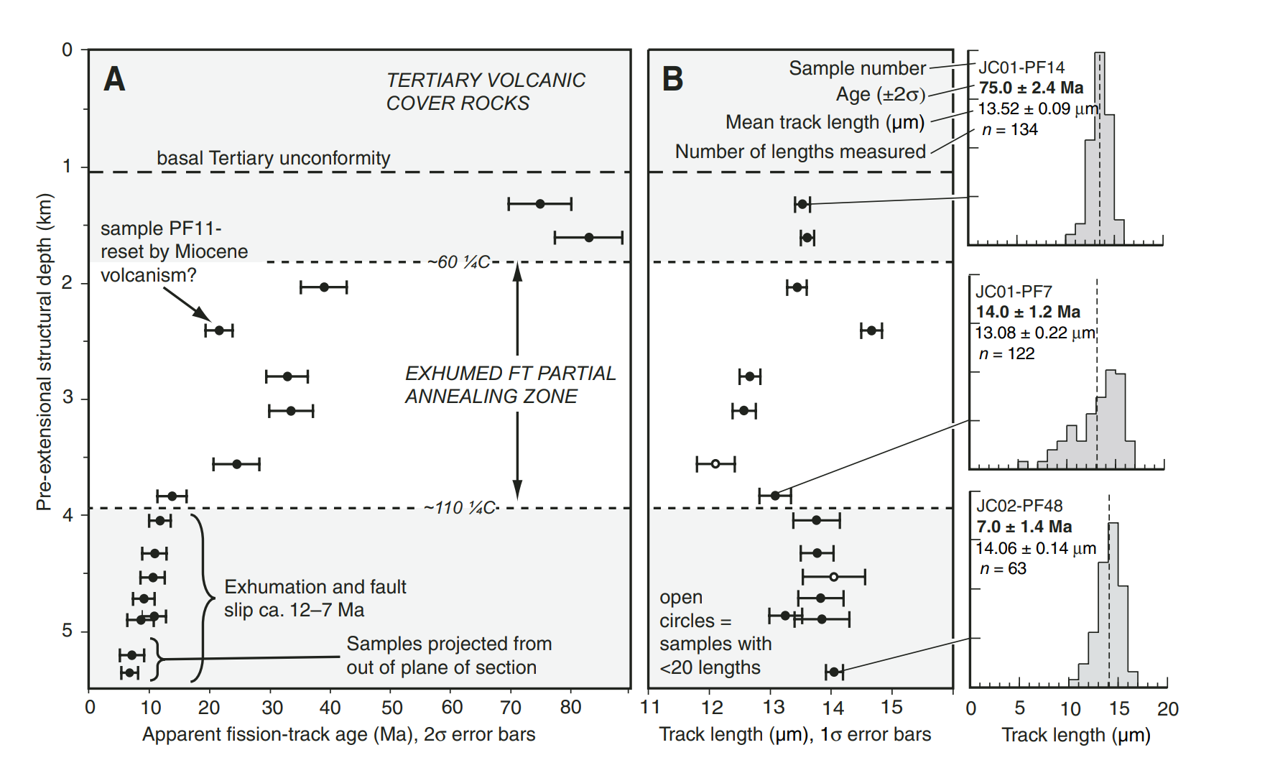
Fission Track Data Shows Rapid Exhumation 12-7Ma
#1
#2
#3

Slide 6
Unextended during peak Oligocene and Mid Miocene volcanism
AFT data = NW Nevada has younger and lesser deformation than central and eastern NV
#1
#2
Rapid Exhumation ~12ma
#3
Unrelated to recent events >70Ma
#1
#2
#3
Slower exhumation in PAZ (40-20Ma)

Slide 7
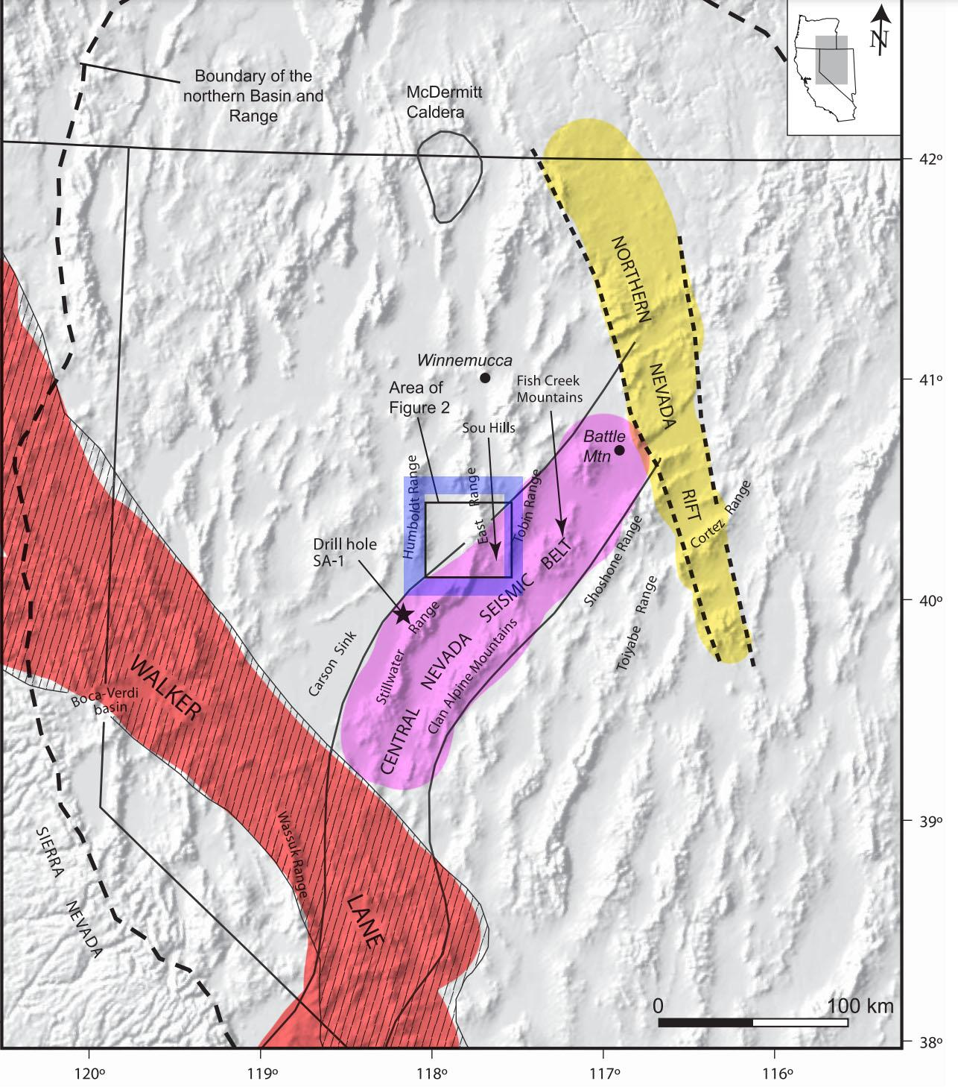
Fosdick and Colgan 2008
Central Nevada slip vs NW Nevada slip
Volcanism accompanied Mid Miocene extension (17-15Ma)
2 phase extensional slip
Mapping + X-cutting relations
Apatite Fission Track + Apatite U-Th/He

Slide 8
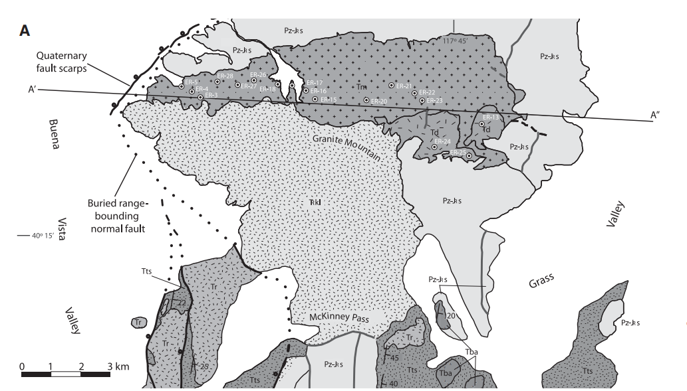
Geologic Mapping in East Ranges Nevada
Older Basalt Flows (17-13Ma)
Oligocene Plutonic Complex (~33Ma)
Oligocene volcanics = dip 30-45°, overlain by younger basalt, dip = 15-20

Slide 9
Geologic Mapping in East Ranges Nevada
17-13Ma faulting = tilted all units 15 degrees
40% extension (x-section)
Older faulting (>17Ma) = tilted Oligocene and older
22% extension assuming 60° dip (x-section)

Slide 10
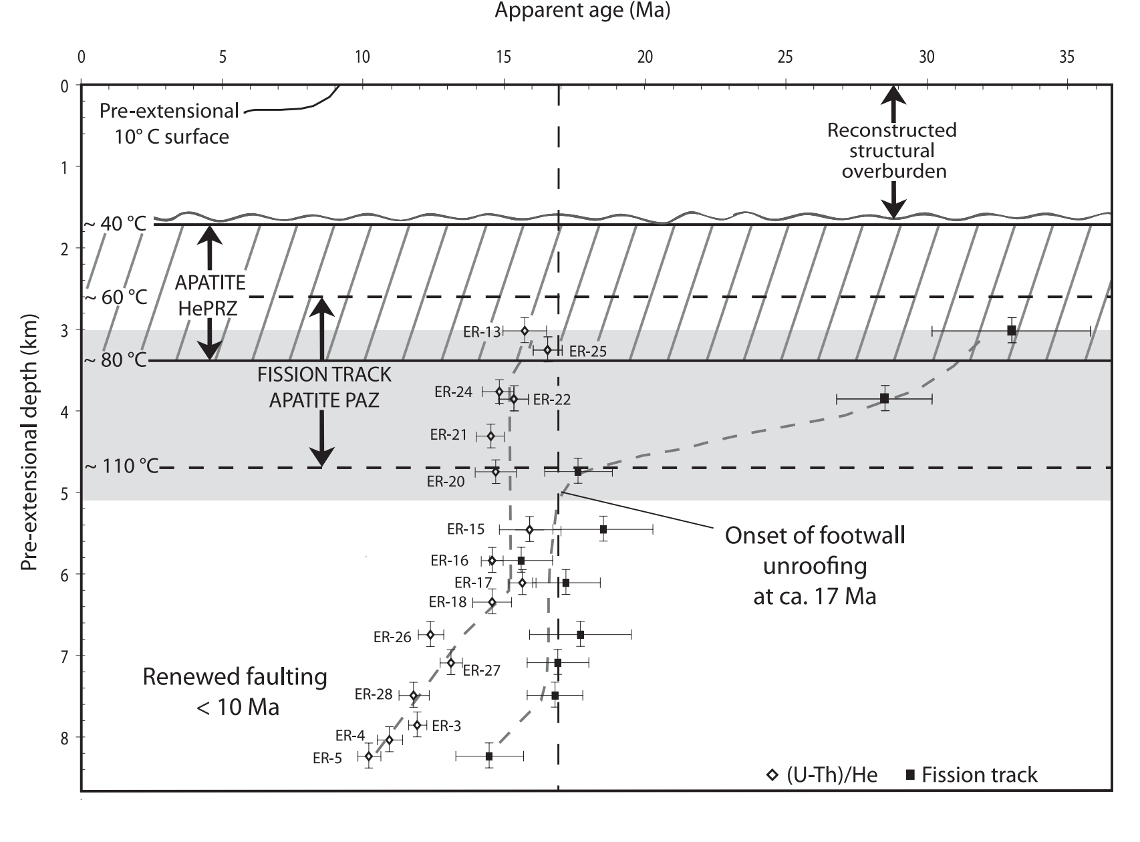
Apatite Data Records Similar Ages
17-13Ma

Slide 11
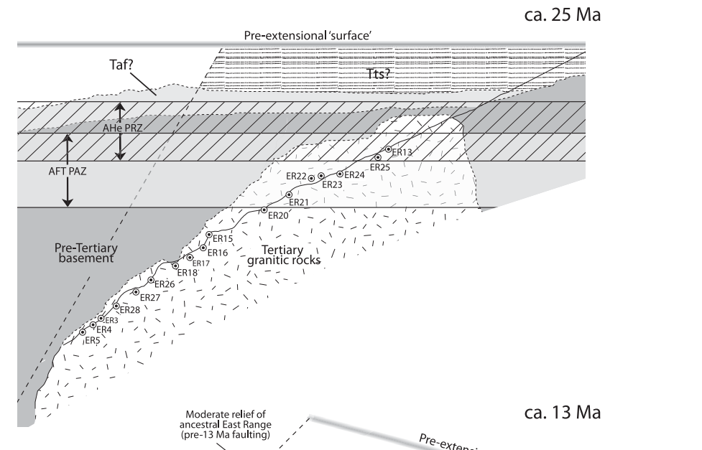
Reconstructed Depth X-Section Profile
Paleohorizon = based on depth estimates + estimated tilt from map
Restores Miocene approximate land surface

Slide 12
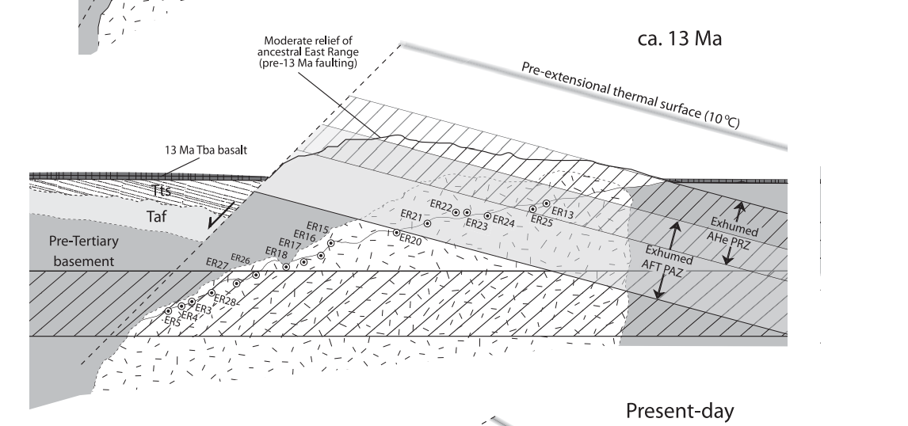
Reconstructed Depth X-Section Profile

Slide 13
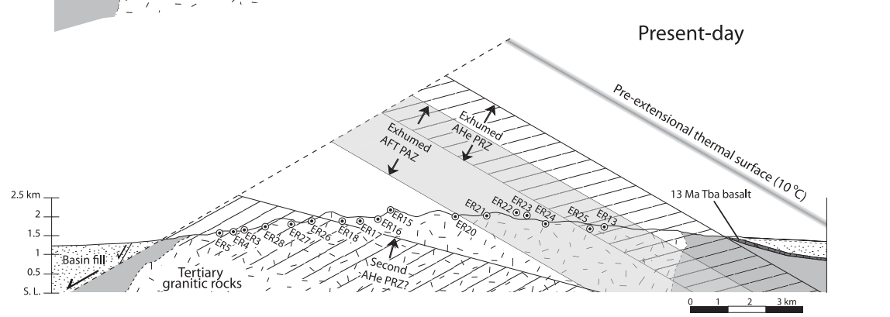
Reconstructed Depth X-Section Profile
Present Day

Slide 14
Northwestern Nevada Pine Mountain Exhumation in Three Tectonic Events
Rapid Exhumation ~12ma
Unrelated to recent events >70Ma
#1
#2
#3
Slower exhumation in PAZ (40-20Ma)
Central Nevada East Range had one rapid exhumation event between 17-13Ma
17-13Ma

Slide 15
Northwest Nevada
Slip = 12-7Ma
Central Nevada
Slip = 17-13Ma

